Slide 1
Augmenting Publicly Available Social Determinants of Health Datasets with Clinical Data to Power Multi-Institutional Clinical Research
Sajjad Abedian, MS
Evan Sholle, MS
Yongkang Zhang, PhD
11/14/2020

Slide 2
Outline
SDH Data Section
What is SDH?
How is it collected?
How to link it?
Interactive: how to create a SDH analytical file?
Clinical Data Section
Interactive: how to create a patient-level analytical file combined with SDH variables?
Association Between Residential Neighborhood Social Conditions and Health Care Utilization and Costs

Slide 3
What is SDH?
And why is it important?

Slide 4
SDH
Neighborhood and Built Environment
Health and Health Care
Social and Community Context
Education
Economic Stability

Slide 5
How is it collected?

Slide 6
Geographical Units

Slide 7
Census Tract vs. Block Group

Slide 8
Census Tract vs. Block Group

Slide 9
Sources
Publicly available data sources
American Community Survey (ACS)
EPA National Air Toxics Assessment
USDA
NYC OpenData
Factors Affecting Communities and Enabling Targeted Services (FACETS)
EHR
Structured
Unstructured

Slide 10
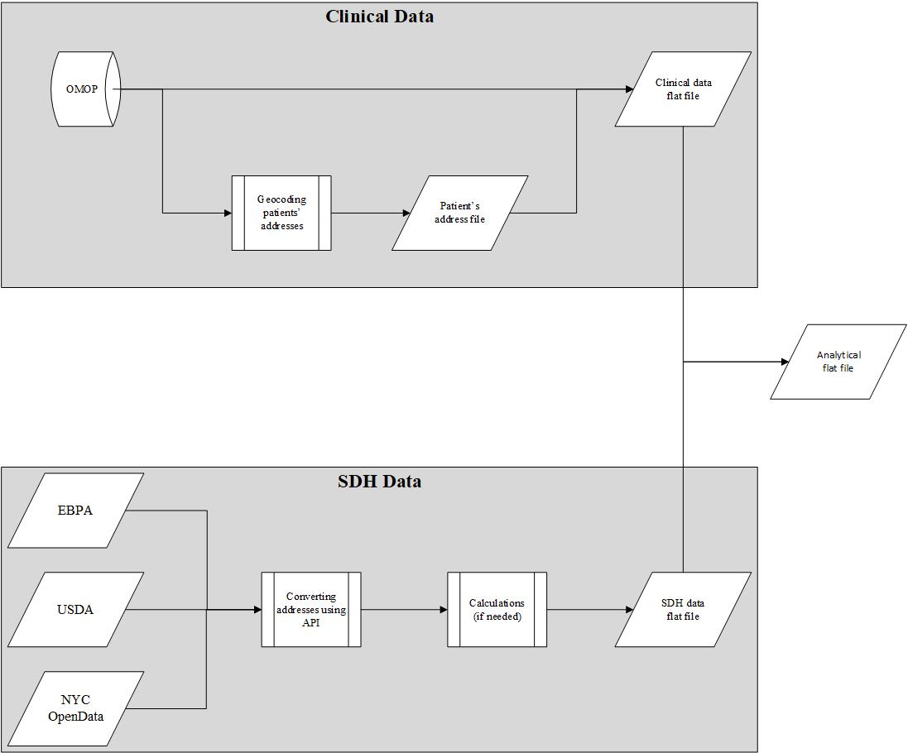
Process of Linking EHR to SDH

Slide 11
VACCINe
Variables Affecting Care in Communities and Individuals in New York
https://github.com/SajjadAbedian/AMIA_2020_VACCINE/blob/main/VACCINe_walkthrough.ipynb

Slide 12
Association Between Residential Neighborhood Social Conditions and Health Care Utilization and Costs
Yongkang Zhang, PhD
11/14/2020

Slide 13
Disclosure
I disclose that neither I nor my partner have relevant financial relationships with commercial interests.

Slide 14
Learning Objectives
Understand strategies to combine social determinants of health data, clinical data, and administrative claims data for health services research.
Understand the associations between disadvantaged neighborhood social conditions and healthcare utilization and costs among Medicare patients.

Slide 15
SDoH and Healthcare
SDoH have strong associations with healthcare quality, utilization, and patient outcomes
Social factors account for 25%–60% of deaths in the United States
Neighborhood social disadvantage is associated with increased risk of 30-day readmission
Food-insecure children are twice as likely to report being in fair or poor health and at least 1.4 times more likely to have asthma, compared to food-secure children

Slide 16
Efforts to Address Social Risk Factors
A growing interest in addressing social risk factors to improve population health among policy makers, researchers, and healthcare providers
Comprehensive screening to identify unmet health-related social needs
Increase patients’ awareness of community services
Navigation services to assist high-risk patients with accessing community services
Alignment between clinical and community services to ensure that community services are available and responsive to the needs of patients

Slide 17
Gaps in Literature
Many studies have found that disadvantaged social conditions are associated with poor clinical outcomes and hospital readmissions
Little is known about how SDoH are associated with other types of potentially preventable healthcare utilization and costs associated with preventable utilization
Limited evidence is available regarding how SDoH influence total healthcare utilization or costs

Slide 18
Objectives of the Study
To examine the associations of neighborhood social conditions with total annual and potentially preventable Medicare costs

Slide 19
Methods: Population and Sample
Medicare fee-for-service patients who had at least one clinical encounter in five major health systems in New York City
Patients with a valid 9-digit zip code in New York or New Jersey
Continuously enrolled in Medicare Parts A and B for 12-month in 2013 and 2014
Had no Medicare Advantage enrollment
93,429 patients were included

Slide 20
Methods: Healthcare Utilization and Costs
Medicare claims data
Healthcare utilization across all care settings and different providers and organizations
Payment made by Medicare, patients, and other payers
Importance of using claims data to measure utilization and costs (Smith et al., JAMIA, 2019).
Total Medicare costs
Standardized total annual Medicare costs across all service categories for 2013 and 2014, including physician services, outpatient services, inpatient services, durable medical equipment, Part D prescription, and post-acute care (e.g., skilled nursing facility and home health) and hospice services

Slide 21
Methods: Healthcare Utilization and Costs
Potentially preventable utilization
Preventable ED visits
Billings’ algorithm
Preventable hospitalizations
AHRQ’s PQI indicators
Unplanned 30-day hospital readmissions
CMS algorithm for pay-for-performance programs
Potentially preventable costs
Standardized episodic costs of all potentially preventable utilization and all services delivered within 30 days after a preventable ED visit or hospitalization for each patient in 2013 and 2014.

Slide 22
Methods: Demographics, Diagnoses, and Procedures
Medicare claims data across all care settings
Electronic health records data for the same patient cohort from multiple health systems in NYC.

Slide 23
Methods: Social Determinants of Health
Multiple choices of SDoH from different resources
Individual or community level?
Medicare claims and EHR data have very limited individual level SDoH: dual-eligible status
Comprehensive SDoH are available at community level
What level of community?
Medicare claims data contain state, county, and 5-digit zip codes of patient residential location
9-digit zip codes are available from EHR data

Slide 24
Methods: Social Determinants of Health
Multiple choices of SDoH from different resources
Data available with different granularity
Neighborhood | Distinct Areas
State | 50
County | 3,200
Zip Code Tabulation Area | 32,000
5-digit Zip Code | 42,000
Census Track | 74,000
Census Block Group | 221,000
Census Block | 11 millions
Possible 9-digit Zip Code | 30 millions
Notes:
Possible 9-digit zip not actual

Slide 25
Methods: Social Determinants of Health
Many policy and economic studies used state for country level SDoH data
Heath policies are developed and implemented at the state or county level
Policy makers need to understand how state or county level SDoH are associated with uptake of health policies among healthcare organizations and providers
Health information technology
Novel payment and delivery models (e.g., ACO)
State or country level SDoH data may be important confounders that need to be adjusted in policy analysis
Notes:
Possible 9-digit zip not actual

Slide 26
Methods: Social Determinants of Health
 | ZIP (Zone Improvement Plan) code | ZCTA (ZIP Code Tabulation Area) code
Developer | United States Postal Service (USPS) | United States Census Bureau
Year of Implementation | 5-digit: 1963 9-digit zip+4: 1983 | Census 2000
Total Numbers | 42,000 | 32,000
Purpose | Introduced as as a method to improve mail delivery service | Tabulate summary statistics
Data availability | Limited | 5-year American Community Survey
Boundary | Could cross states | In a few cases, ZCTAs can cross into bordering states
Frequency of change | ZIP codes change frequently. Every year there are thousands of changes to the USPS ZIP Code records. | Could be stable for 10 years or more.
Notes:
Possible 9-digit zip not actual

Slide 27
Methods: Social Determinants of Health
Census block groups: small, relatively homogenous areas of 600-3,000 persons
Census tracts: aggregates several block groups, and represent approximately 4,000 persons
Many SDoH measures are available at both tract and block group level
American Community Survey
Notes:
Possible 9-digit zip not actual

Slide 28
Methods: Social Determinants of Health
Multiple choices of SDoH from different resources
Composite score or individual measures?
Individual measures reflecting important neighborhood socioeconomic status: median household come, unemployment rate, % of people without high school degree etc.
Composite scores: a summary of neighborhood social conditions across different measures: Area Deprivation Index, Social Deprivation Index, Social Vulnerability Index etc.

Slide 29
Methods: Social Determinants of Health
Multiple choices of SDoH from different resources
Area Deprivation Index
Components for Area Deprivation Index | Weight
Percentage of population aged ≥ 25 with < 9 years of education | 0.0849
Percentage of population aged ≥ 25 with at least a high school diploma | -0.0970
Percentage of employed persons aged ≥ 16 in white collar occupations | -0.0874
Median family income | -0.0977
Income disparity (log of 100 * ratio of the number of households with < $10,000 annual income to the number of households with ≥ $50,000 annual income) | 0.0936
Median home value | -0.0688
Median gross rent | -0.0781
Median monthly mortgage | -0.0770
Percentage of owner-occupied housing units (home ownership rate) | -0.0615
Percentage of civilian labor force population aged ≥ 16 unemployed (unemployment rate) | 0.0806
Percentage of families below the poverty level | 0.0977
Percentage of population below 150% of the poverty threshold | 0.1037
Percentage of single-parent households with children aged < 18 | 0.0719
Percentage of occupied housing units without a motor vehicle | 0.0694
Percentage of occupied housing units without a telephone | 0.0877
Percentage of occupied housing units without complete plumbing | 0.0510
Percentage of occupied housing units with >1 person per room | 0.0556

Slide 30
Methods: Social Determinants of Health
Multiple choices of SDoH from different resources
Area Deprivation Index

Slide 31
Methods: Data Linkage
Using EHR data as a bridge between SDoH and Medicare Data
EHR data
Encrypted patient ID
9-digit zip codes
Patient ID-Bene ID
crosswalk
ZIP-FIPS crosswalk
Encrypted Medicare beneficiary ID
12-digit FIPS code for census block groups
Medicare claims data
SDoH

Slide 32
Analysis: Descriptive Analysis
We first compared differences in demographics, comorbidities, and other patient characteristics across patients in different ADI quintiles
Demographics: age, sex, and race
Comorbidities: number of chronic conditions, frailty, serious mental illness, serious physical illness, and end-stage renal disease
CMS Hierarchical Condition Categories score for each patient to measure the.
Dual-eligible status and Medicare Part D coverage
We used χ2 tests for categorical variables and t-tests for continuous variables to test for differences in patient characteristics across ADI quintiles.

Slide 33
Analysis: Multivariable Analysis
Generalized linear models (GLM) to examine the association of ADI quintiles with (1) Total annual Medicare costs and (2) Cost associated with preventable utilization
We also tested the association between ADI quintiles and the probability of having the three types of the preventable utilization by using logistic regressions

Slide 34
Analysis: Multivariable Analysis
We focused on the neighborhoods with the least disadvantaged conditions (quintile 1) and the most disadvantaged conditions (quintile 5), as compared with the neighborhoods with the intermediate level conditions (quintile 3)
All regressions were adjusted for demographic, comorbidities, and other patient characteristics of each year
We additionally added year-fixed effects to control for secular changes in outcomes and indicators for hospital referral regions to account for supply side variations across regions

Slide 35
Results: Descriptive Analysis
Geographic location and social conditions

Slide 36
Results: Descriptive Analysis
Geographic location and social conditions

Slide 37
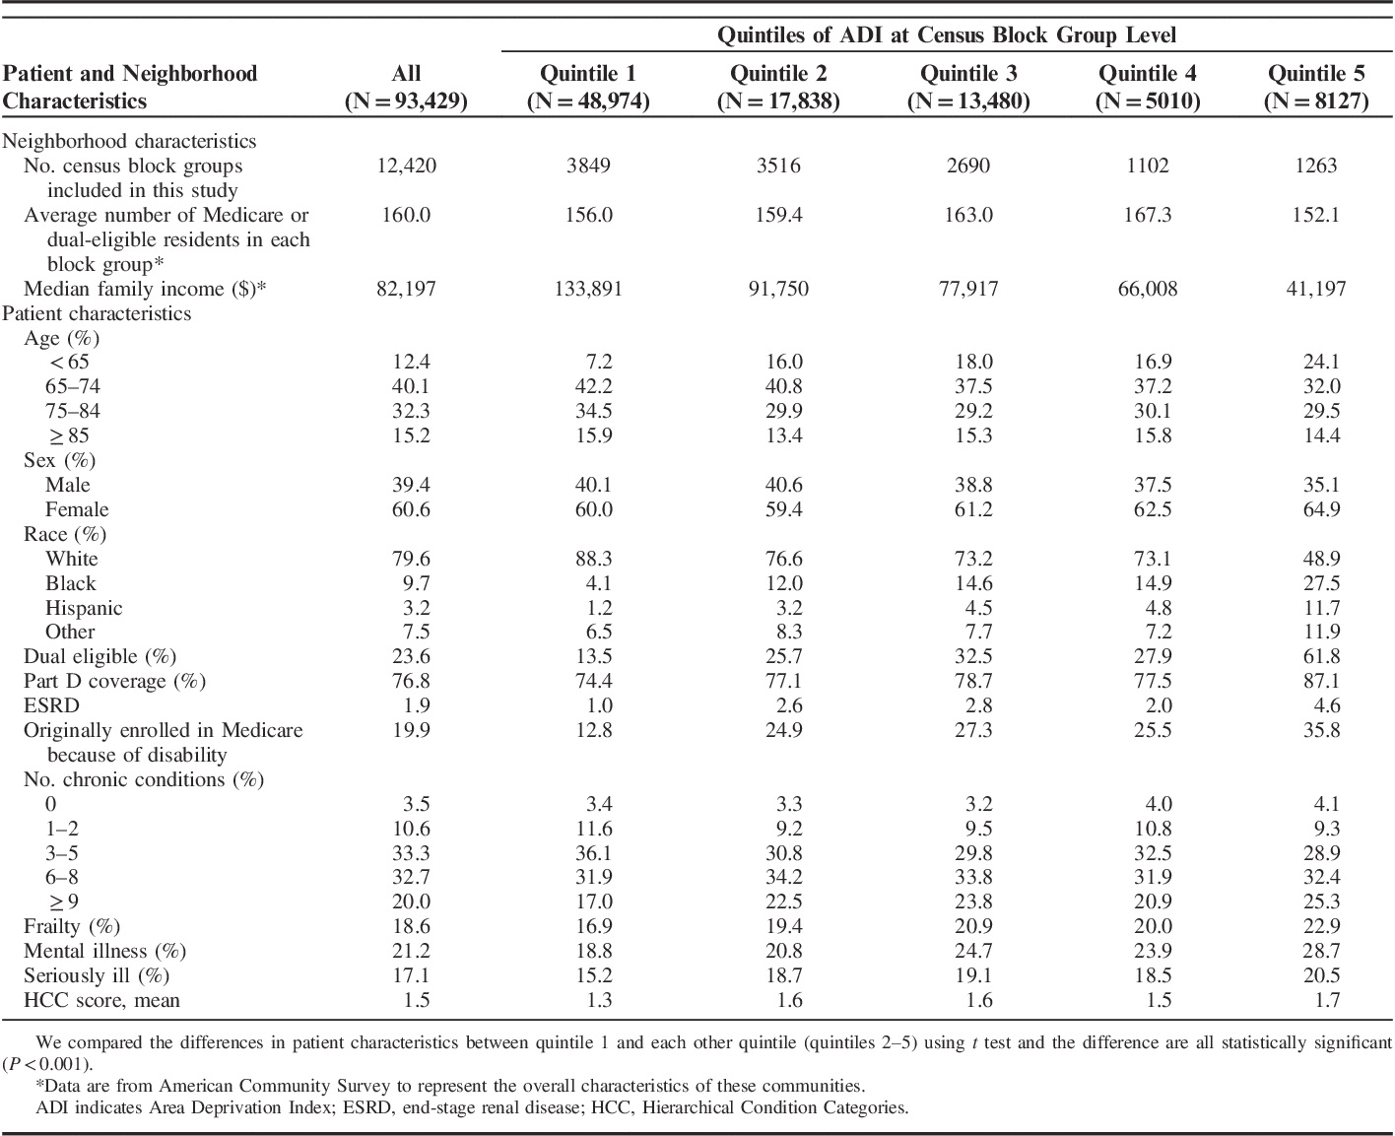
Results: Descriptive Analysis
Patients with different social conditions have different characteristics.

Slide 38
Results: Descriptive Analysis
Patients with disadvantaged social conditions have higher unadjusted Medicare spending
 | Average total annual Medicare costs ($) | Physician ($) | Outpatient ($) | Inpatient ($) | Post-acute care and hospice ($) | DME ($) | Part D ($)
ADI, quintile 1 | 17,661 | 5,928 | 2,460 | 3,744 | 1,732 | 230 | 3,566
ADI, quintile 2 | 22,965 | 6,880 | 3,210 | 5,260 | 2,400 | 325 | 4,890
ADI, quintile 3 | 23,841 | 6,867 | 3,311 | 5,305 | 2,665 | 336 | 5,356
ADI, quintile 4 | 21,564 | 6,174 | 2,965 | 4,830 | 2,567 | 312 | 4,716
ADI, quintile 5 | 26,815 | 6,174 | 4,154 | 6,001 | 2,969 | 432 | 6,860
Average | 20,670 | 6,398 | 2,901 | 4,514 | 2,147 | 285 | 4,425

Slide 39
Results: Descriptive Analysis
Patients with disadvantaged social conditions have higher unadjusted preventable spending and utilization
 | Potentially preventable Medicare costs ($) | Preventable ED visits (%) | Preventable hospitalizations (%) | 30-day readmissions (%) *
ADI, quintile 1 | 1,343 | 8.7 | 3.7 | 13.7
ADI, quintile 2 | 2,260 | 11.9 | 5.4 | 16.8
ADI, quintile 3 | 2,568 | 13.3 | 6.1 | 18.3
ADI, quintile 4 | 2,232 | 13.5 | 5.6 | 18.9
ADI, quintile 5 | 3,361 | 18.5 | 8.1 | 20.0
Average | 1,918 | 11.1 | 4.8 | 16.3
* Analysis only using hospitalized patients

Slide 40
Results: Multivariable Analysis
Compared with the neighborhoods with intermediate level social conditions (quintile 3), the least disadvantaged neighborhoods (quintile 1) was associated with higher total Medicare costs ($427 or 3.2% higher, P<0.001)
The most disadvantaged neighborhoods (quintile 5) had similar total Medicare costs ($22 or 0.2% lower, P=0.89) after adjusting for patient demographics, comorbidities, and other characteristics

Slide 41
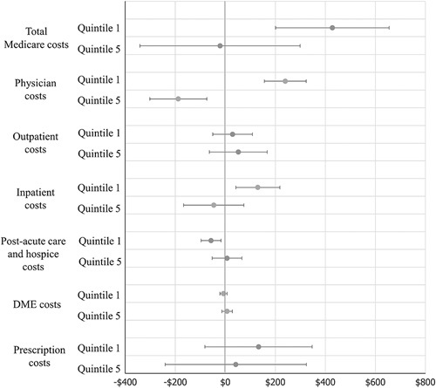
Results: Multivariable Analysis
The association between social disadvantage and spending varies by care setting

Slide 42
Results: Multivariable Analysis
Compared with the neighborhoods with intermediate level social conditions (quintile 3), the least disadvantaged neighborhoods (quintile 1) had similar potentially preventable costs (−$23; 95% CI, −$56 to $10)
The most disadvantaged neighborhoods (quintile 5) had higher potentially preventable costs ($53; 95% CI, $1–$104) than patients with the intermediate level social conditions

Slide 43
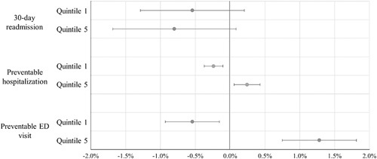
Results: Multivariable Analysis
The association between social disadvantage and preventable healthcare utilization

Slide 44
Discussions
Disadvantaged neighborhood conditions are associated with lower total annual Medicare costs but higher potentially preventable costs after controlling for demographic, medical, and other patient characteristics.
Socioeconomic barriers may limit access and use of primary care and disease management services, resulting in a higher proportion of their health care costs going to potentially preventable care.

Slide 45
Discussions
Results of this study do not necessarily indicate causal relationships between social conditions and health care utilization and costs
This study was not able to incorporate individual level SDoH in the analysis and therefore cannot examine if the associations of community SDoH are still significant after controlling for individual level SDoH
The 3 types of preventable utilization may not all be truly preventable; alternatively these services may not represent the totality of preventable utilization

Slide 46
Acknowledgement
Patient-Centered Outcomes Research Institute Health Systems PCORnet (Patient-Centered Clinical Research Network) Demonstration Project (HSD-1604-35187, PI: Kaushal)
National Institute on Aging Pathway to Independence Award (K99AG064030, PI: Zhang)

Slide 47
References
Amarasingham R, Moore BJ, Tabak YP, et al. An automated model to identify heart failure patients at risk for 30-day readmission or death using electronic medical record data. Med Care 2010;48:981–8.
Meddings J, Reichert H, Smith SN et al. The impact of disability and social determinants of health on condition-specific readmissions beyond Medicare risk adjustments: A cohort study. J Gen Intern Med 2017;32:71–80.
Blum AB, Egorova NN, Sosunov EA, Gelijns AC, DuPree E, Moskowitz AJ, Federman AD, Ascheim DD, Keyhani S. Impact of socioeconomic status measures on hospital profiling in New York City. Circ Cardiovasc Qual Outcomes 2014;7:391–397.
Keyhani S, Myers LJ, Cheng E, et al. Effect of clinical and social risk factors on hospital profiling for stroke readmission: a cohort study. Ann Intern Med 2014;161:775–84. doi:10.7326/M14-0361.
Jamei M, Nisnevich A, Wetchler E, Sudat S, Liu E. Predicting all-cause risk of 30-day hospital readmission using artificial neural networks. PLoS One. 2017;12(7):e0181173.
Leveraging Data-Driven Insights to Support Development Of Targeted Supplemental Benefits Under Newly Expanded Flexibilities In Medicare Advantage To Improve Outcomes In High-Cost, High-Need Beneficiaries. AcademyHealth, 2019.
Donze J, Aujesky D, Williams D, Schnipper JL. Potentially avoidable 30-day hospital readmissions in medical patients: derivation and validation of a prediction model. JAMA Intern Med 2013;173:632-8.

Slide 48

Thank you!
Yongkang Zhang, PhD
Research Associate
Department of Healthcare Research & Policy
Division of Health Policy and Economics yoz2009@med.cornell.edu

